Slide 1
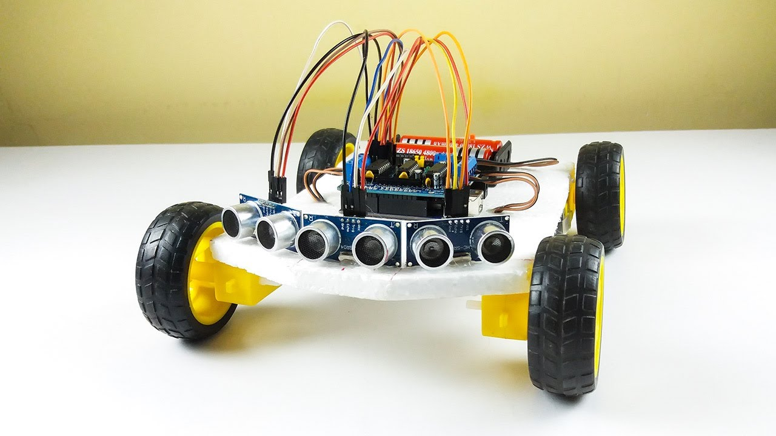
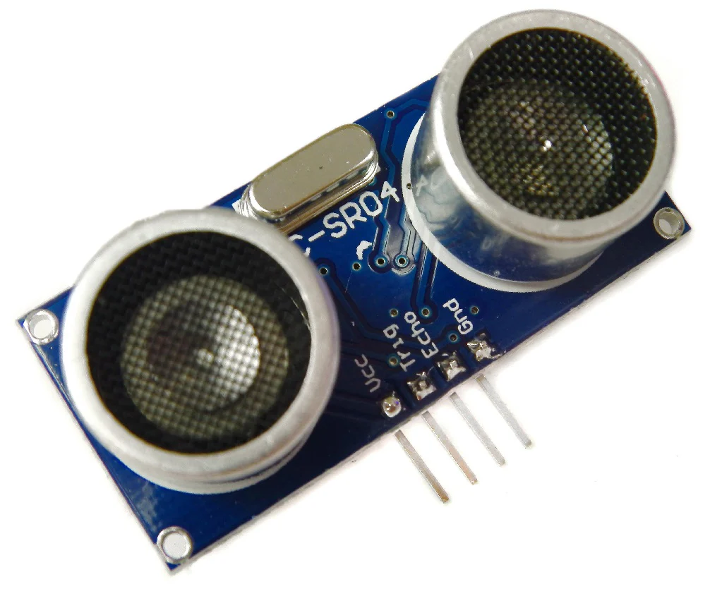
Ultrasonic Sensors

Slide 2
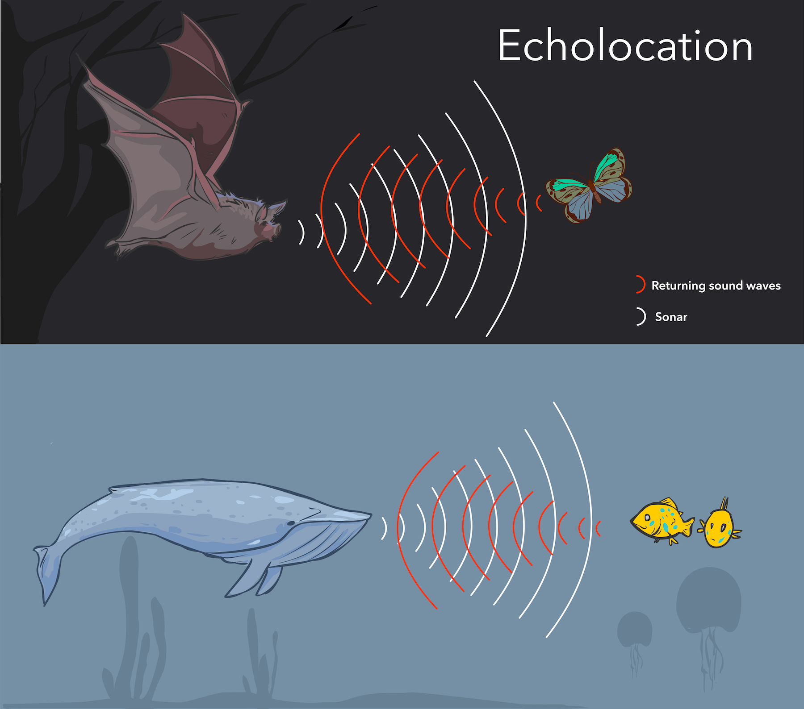
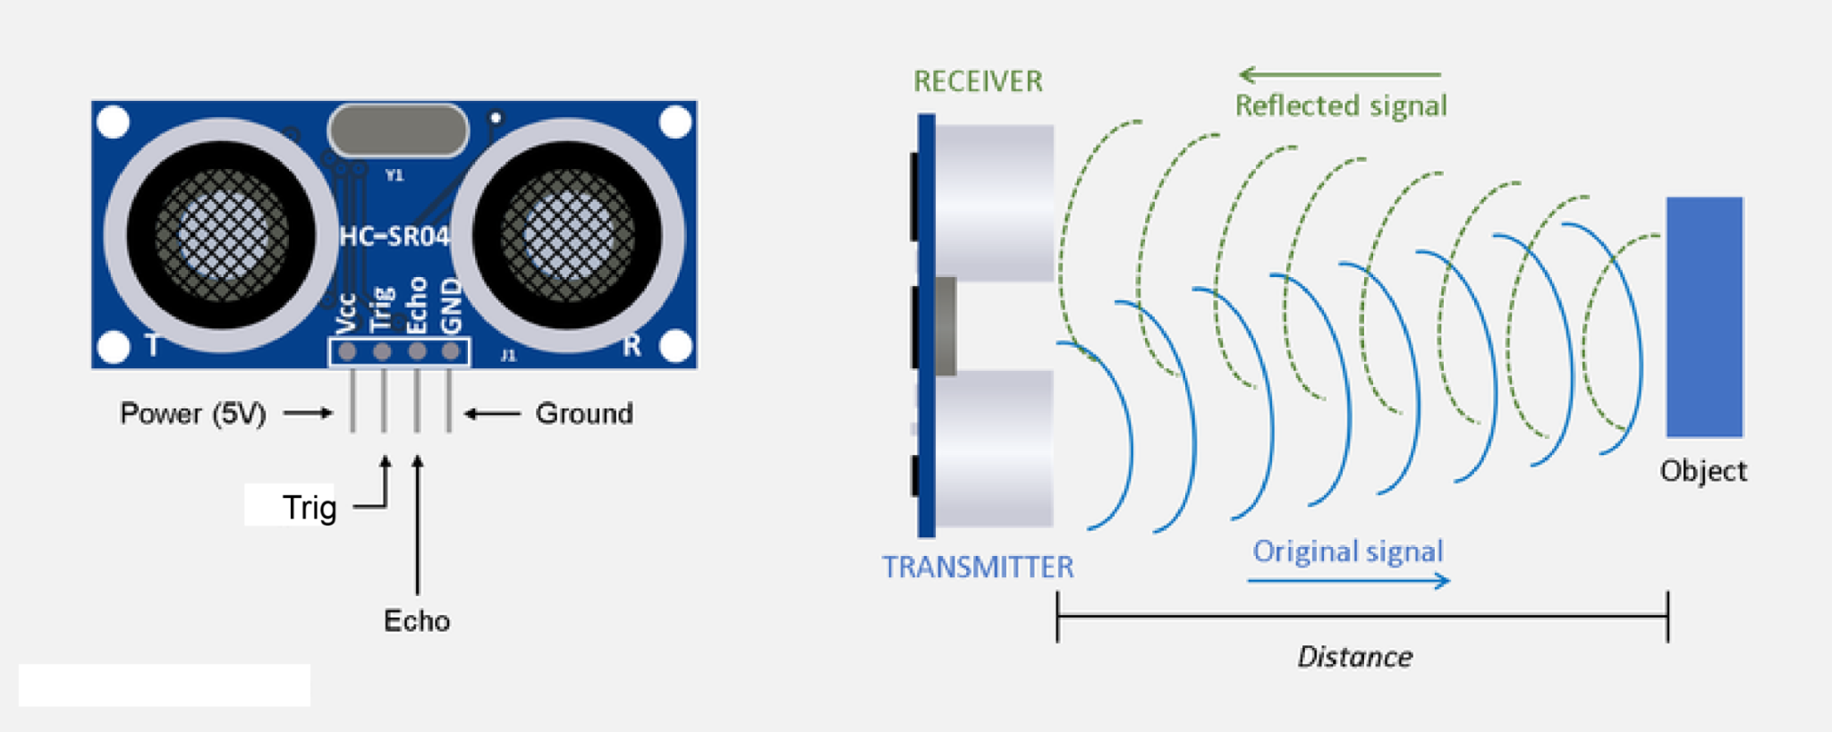
What is an Ultrasonic Sensor?
An ultrasonic sensor is a device that uses sound waves to measure distance. It sends out high-frequency sound waves (ultrasound) that humans can't hear, waits for the sound to bounce off an object, and then calculates the distance based on how long it takes for the sound to return.

Slide 3
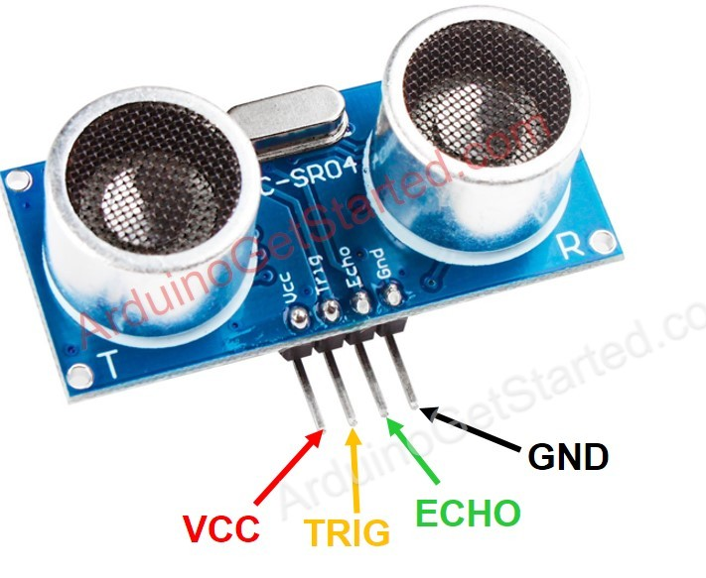
HC-SR04 Ultrasonic sensor Pinout

Slide 4
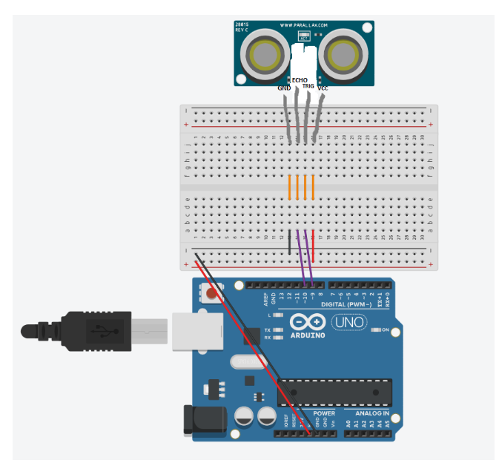
Ultrasonic sensor wiring via breadboard
Find the code via the link :]
Getting Started with the HC-SR04 Ultrasonic sensor | Arduino Project Hub

Slide 6
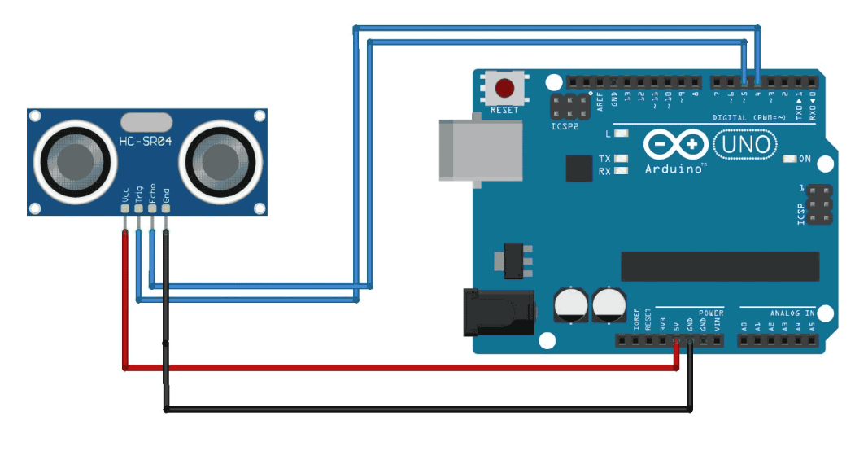
Ultrasonic sensor wiring w/o breadboard
Code for Arduino and Ultrasonic Sensor
How to Interface Arduino with an Ultrasonic Sensor?

